Slide 1
Fitness Modeling Approaches
System | Random Effects | Distribution | Software | Model Validation | Model Selection
NSNT Previous | No | QuasiPoisson | JMP | No* | No*
NSNT Dayan 1 (reproduce) | No | NegBin | R | yes | No*
NSNT Dayan 2 (GLM) | No | Search: NegBin | R | yes | yes
NSNT Dayan 3 (GLMM) | Yes? | ? | R | Yes | Yes
McKenzie | No AND release group | NegBin and QuasiPoisson | R and JMP | No | Yes/No

Slide 2
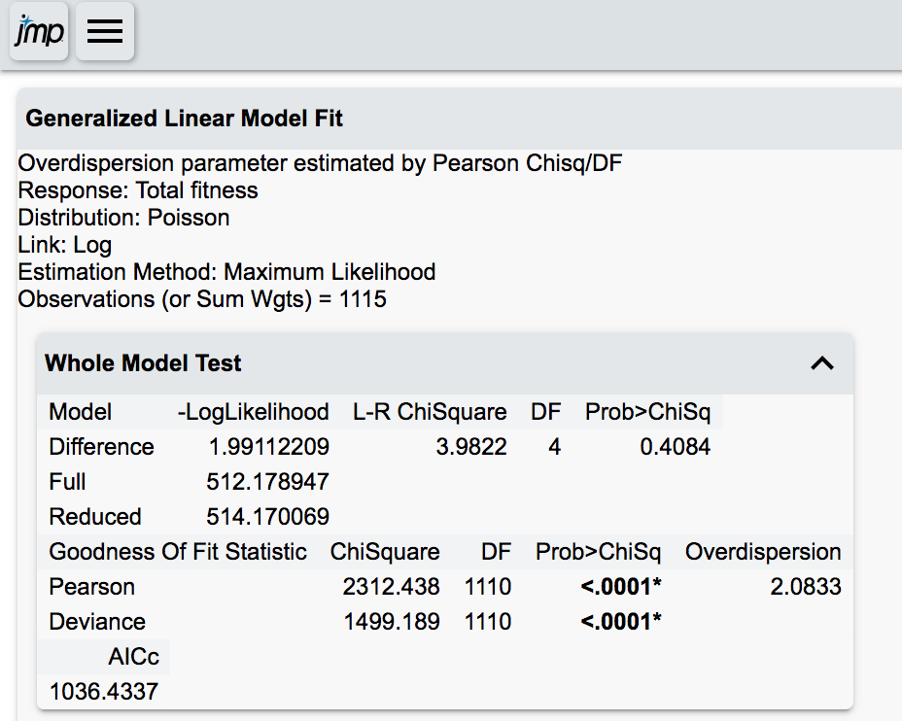
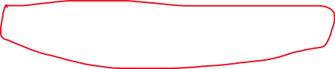
No bad models, only better and worse fits
JMP Results Draft Report (2013)
This is a poor fitting model:
Deviance residuals greater than df
fails goodness of fit tests, but we don’t know why
Quasipoisson (overdispersion parameter) corrects for overdispersion in the standard errors of parameter estimates, but the estimates themselves could still be problematic. we can’t tell because we don’t evaluate fit

Slide 3
2013 data fit by a Poisson:
parameter estimate p-values and errors corrected with overdispersion parameter
Notes:
A overdispersion parameter will make sure we don’t get too optimistic with P-values, but it can’t correct for this fit.

Slide 4
Dayan 1 (GLM): (what is currently in the report)
Reproduce what was done earlier, just change the distribution used to negative binomial
and conduct full model validation

Slide 5
Problems with Dayan 1 (GLM)
Improved the fit
No bad models, only better and worse fits
No significant effects in 2011, 2012 and 2013
2014 still had some fit issues and is not significant globally
2015 fit was okay and significant, but only tells us males do worse than females
In one of five years, males do better than females? What are we supposed to do with this knowledge?
Can we change our approach to modeling to get more power/fit more informative models?
Start from scratch with per-year models (Dayan 2 (GLM))
Combine data across years using mixed models (Dayan 3 (GLMM))

Slide 6
Dayan 2 GLM – Starting from Scratch
Exploratory Data Analysis
what patterns do we see?
Missing Covariates
can we think of any predictors that are missing from the model?
Non-linear effects
we know that migration timing is under stabilizing selection within a run type, why model it as linear effect?
intuitively, shouldn't there be an optimum outplanting density?
What distribution is appropriate?
overdispersed count data with lots of zeros:
is the overdispersion due to missing covariates, unaccounted for zeros generating process, actual property of the response variable?
Poisson, Negative Binomial, ZIP, ZINB, Hurdle models

Slide 7
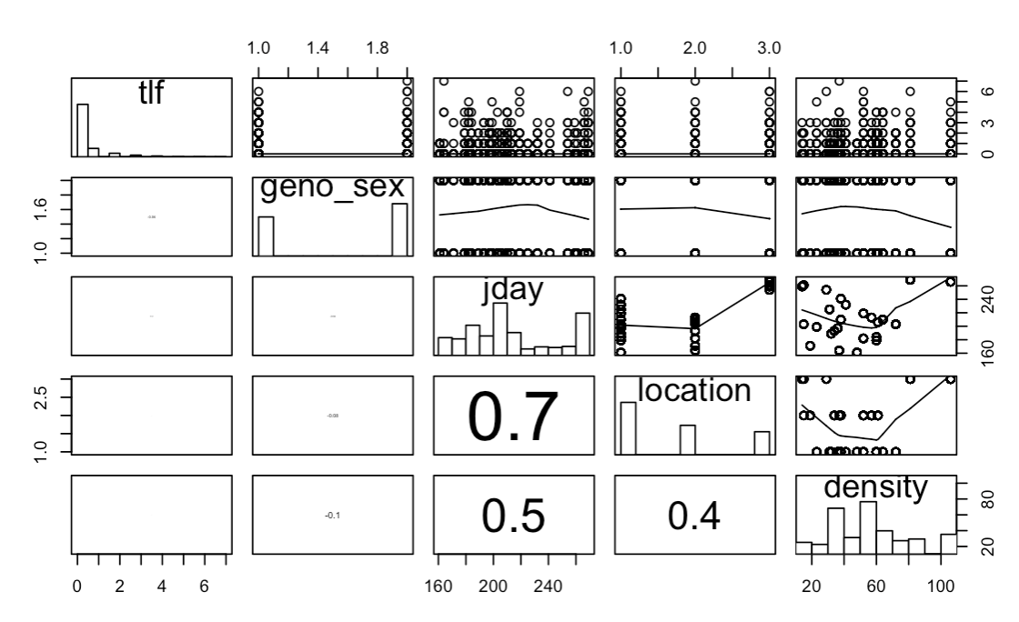
Dayan 2 GLM – Starting from Scratch
Brief Conclusions: Exploratory Data Analysis
Location and Julian Day of Release are nearly always strongly collinear

Slide 8
Dayan 2 GLM – Starting from Scratch
Brief Conclusions: Missing Covariates
The number of fish released at a given location on a given day improves model fit according to AIC, BIC and likelihood-ratio tests in multiple years
Modeling release day and density as non-linear effects is usually not worth the cost in degrees of freedom, often time it’s the interaction with sex that matters
Include density, do model selection for non-linear effects in each year

Slide 9
Dayan 2 GLM – Starting from Scratch
Brief Conclusions: Distribution
AIC
BIC
899
927
813
842
832
866
815
853
819
880

Slide 10
Dayan 2 GLM
Results
Year | Significant Effects | Model Validation | Collinearity of sig effects?
2011 |  | Good
2012 | Density | Good | Location * Density
2013 |  | Good
2014 | Sex + Density + Sex*Density | Good
2015 | Sex + Location | Good | Location * Date
Results for 2012 and 2015 challenging to interpret due to collinearity
Significant release group level effects (e.g density) suggest that release group should be controlled as a random effect and/or specific fixed effects that vary across release groups should be modeled (density, sex ratio)
Collinearity problems and variation in results across years suggests we’d benefit from the shrinkage of fitting year as random effect

Slide 11
Effect | Estimate (link-scale) | Estimate SE | P-value (likelihood ratio test)
Sex(Male) | -1.84 | 0.49 | 0.0002***
Density | -0.018 | 0.009 | 0.04*
Sex(M)*Density | 0.036 | 0.012 | 0.002**
2014
Controlling sex ratios and the number of fish released at a time could have a large effect on fitness

Slide 12
Questions to address through mixed modeling:
Will the shrinkage from combining across years increase our power to find significant predictors effects on fitness?
Can mixed modeling solve our collinearity problems? i.e. can we parse location effects from date and density effects by combining data across years
Are the density effects we see in individual years driven by sex ratios
Do predictors operate at the level of release group (as our density results suggest)?
Final model:
built a “beyond optimal” mixed model with same covariates as before + sex ratios for each release group + sex ratio for each year + total outplant size each year and some interactions I thought were interesting
including year levels effects in the fixed effect structure was a better fit to the data than including year as a random effect.
final model
TLF ~ sex + location + annual sex ratio + release group sex ratio + sex*location + annual sex ratio*sex + release group sex ratio * sex

Slide 13
Mixed Model Results
Outline of Approach
Identify collinearity problems and evaluate severity using VIFs
Fit “beyond optimal” model
any possible fixed effect (except collinear ones) and random effect
Choose random effects structure while retaining the “beyond optimal” fixed structure
Model selection for fixed effects
Likelihood Ratio Test (effects improves fit to data)
Backward Stepwise Selection based on significant Wald test (null: effect is equal to zero)
Conduct model validation on the final model
Estimate marginal means of effects, backtransform effects to clearly communicate meaning of model

Slide 14
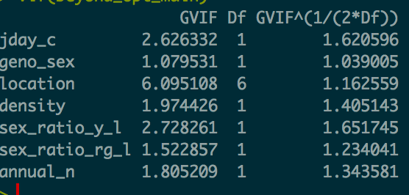
Mixed Model Results

Slide 15
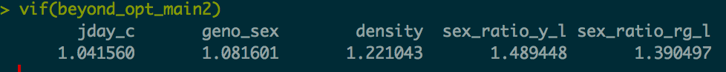
Mixed Model Results
Removing Location:
Compared the model fit without annual_n and annual sex ratio
Removing Location and Annual N:
Starting (beyond optimal) Model:
Main Fixed Effects: Julian Day of Release (centered), Sex, Density of Release Group, Sex Ratio of Release group, Sex Ratio for Entire Year
Interactions: Sex Ratio (annual) * Sex, Sex Ratio (Release Group) * Sex, Sex * Density, Sex Ratio (annual) * Density, Sex Ratio (release group) * Density
Random Effects: Release Group, Year

Slide 16
Mixed Model Results
Starting (beyond optimal) Model:
Main Fixed Effects:
Julian Day of Release (centered)
Sex
Density of Release Group
Sex Ratio of Release group
Sex Ratio for Entire Year
Interactions:
Sex Ratio (annual) * Sex
Sex Ratio (Release Group) * Sex
Sex * Density
Sex Ratio (annual) * Density ?
Sex Ratio (release group) * Density ?
Random Effects:
Release Group
Year
Random Effects Model Selection:
Main Fixed Effects:
Julian Day of Release (centered)
Sex
Density of Release Group
Sex Ratio of Release group
Sex Ratio for Entire Year
Interactions:
Sex Ratio (annual) * Sex
Sex Ratio (Release Group) * Sex
Sex * Density
Sex Ratio (annual) * Density
Sex Ratio (release group) * Density
Random Effects:
Release Group
Year
Fixed Effects Model Selection:
Main Fixed Effects:
Julian Day of Release (centered)
Sex
Density of Release Group
Sex Ratio of Release group
Sex Ratio for Entire Year
Interactions:
Sex Ratio (annual) * Sex
Sex Ratio (Release Group) * Sex
Sex * Density
Sex Ratio (annual) * Density
Sex Ratio (release group) * Density
Random Effects:
Release Group
Year
REML fit
Model Selection by:
AIC
LRT
ML fit
Model Selection by:
Backward Stepwise (Wald Test)
LRT

Slide 17
Mixed Model Results
Final Model:
Main Fixed Effects:
Sex
Sex Ratio for Entire Year
Random Effects:
Release Group

Slide 18
Mixed Model Results

Slide 19
Mixed Model Results
Final Model:
Main Fixed Effects:
Sex
Sex Ratio for Entire Year
Random Effects:
Release Group

